Slide 1
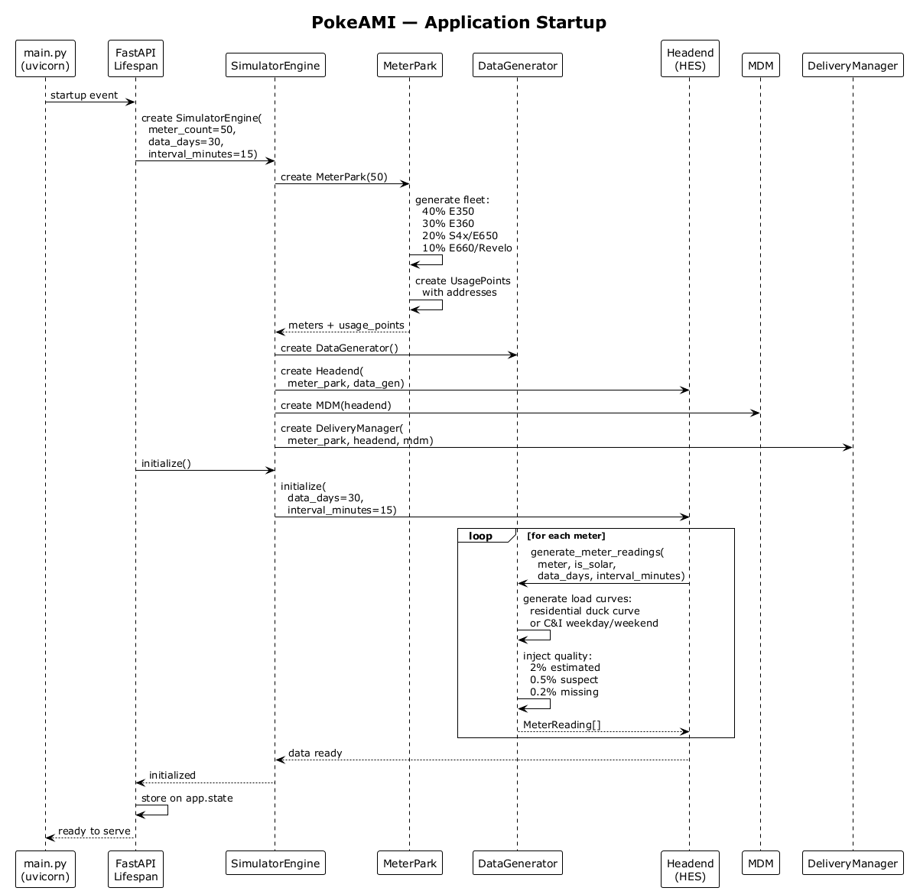
PokeAMI — Application Startup
main.py (uvicorn)
FastAPI Lifespan
SimulatorEngine
MeterPark
DataGenerator
Headend (HES)
MDM
DeliveryManager
startup event
create SimulatorEngine( meter_count=50, data_days=30, interval_minutes=15)
create MeterPark(50)
generate fleet: 40% E350 30% E360 20% S4x/E650 10% E660/Revelo
create UsagePoints with addresses
meters + usage_points
create DataGenerator()
create Headend( meter_park, data_gen)
create MDM(headend)
create DeliveryManager( meter_park, headend, mdm)
initialize()
initialize( data_days=30, interval_minutes=15)
loop
[for each meter]
generate_meter_readings( meter, is_solar, data_days, interval_minutes)
generate load curves: residential duck curve or C&I weekday/weekend
inject quality: 2% estimated 0.5% suspect 0.2% missing
MeterReading[]
data ready
initialized
store on app.state
ready to serve
main.py (uvicorn)
FastAPI Lifespan
SimulatorEngine
MeterPark
DataGenerator
Headend (HES)
MDM
DeliveryManager

